Slide 1
Use of iohexol clearance in dogs as a diagnostic test – does it help in early diagnosis of kidney disease?
Dr. L. PELLIGAND, lpelligand@rvc.ac.uk
DMV, Cert. VA, Dipl. ECVAA Dipl. ECVPT, PhD, MRCVS
Senior Lecturer in Veterinary Pharmacology and Anaesthesia

Slide 2
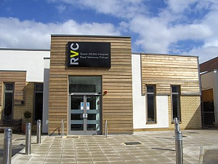
My background / Disclosures
Veterinary anaesthesia and analgesia boarded clinician
Pharmacology diplomate
  Analgesics/sedatives
  Antimicrobial drugs
  GFR testing service
Interest Disclosure | Organisations
Concept Development Partnership | deltaDOT
Grant recipient | Elanco, Zoetis, VMD, Transpharmation, Petplan
Consultant | VetCare, Triveritas
Steering Committee | VetCAST, AHMS&S

Slide 3
What are the markers commonly used to diagnose kidney disease in dogs?
Plasma creatinine
Azotaemia onset :
> 75% of nephron mass lost
Urinary
Specific
Gravity
Blood
Urea
Loss of urine concentration ability: > 66% of nephron mass lost
Non-renal factors influence USG
(drugs, diet or fluid intake)
Lack of specificity
(prerenal, GI bleed)

Slide 4
Creatinine has been used to assess renal function for nearly a century…
Otto Folin (1867-1934)
Huge contribution to clinical
pathology, especially in renal patients
Published (1919) applicable
method to measure creatinine in patients
(colorimetric method using Jaffe’s reaction)
Found that chemically induced nephritis in cats led to nitrogen retention

Slide 5
… and creatinine is still the current standard
Easy routine measurement
Allows harmonisation following the International Renal Interest Society staging (IRIS)
Different survival times associated with different levels of IRIS staging

Slide 6
Possible pitfalls of creatinine measurement
Creatinine is also a marker of muscle mass (and body weight):
  - dog breed with high muscle mass (greyhounds)
  - cats with poor muscle mass
Creatinine concentrations vary depending on the method of analysis (colorimetric vs enzymatic), leading to differences between analysers and laboratories
Creatinine is insensitive at detecting reduction in the renal mass: produces fewer false-positive results but more false negative results compared to urea

Slide 7
Canine reference ranges in 9 UK laboratories compared to IRIS thresholds

Slide 8
Large change in creatinine but little change in GFR (advanced renal failure)
Large change in GFR but little change in creatinine (early CKD)
Slide: N. Finch thesis
A reduction in GFR from 3.0 to 1.5 ml/min/kg resulted in a corresponding increase in plasma creatinine of only approximately 100 to 150 μmol/L

Slide 9
How else can we quantify renal function?
Measurement of glomerular filtration rate is the best method for assessing renal function as it is directly proportional to functional renal mass
(Kerl and Cook 2005)
Markers used clinically for plasma clearance
    Iohexol (4h test) / Exogenous creatinine (10h test)
Test traditionally viewed as too impractical to be used clinically

Slide 10
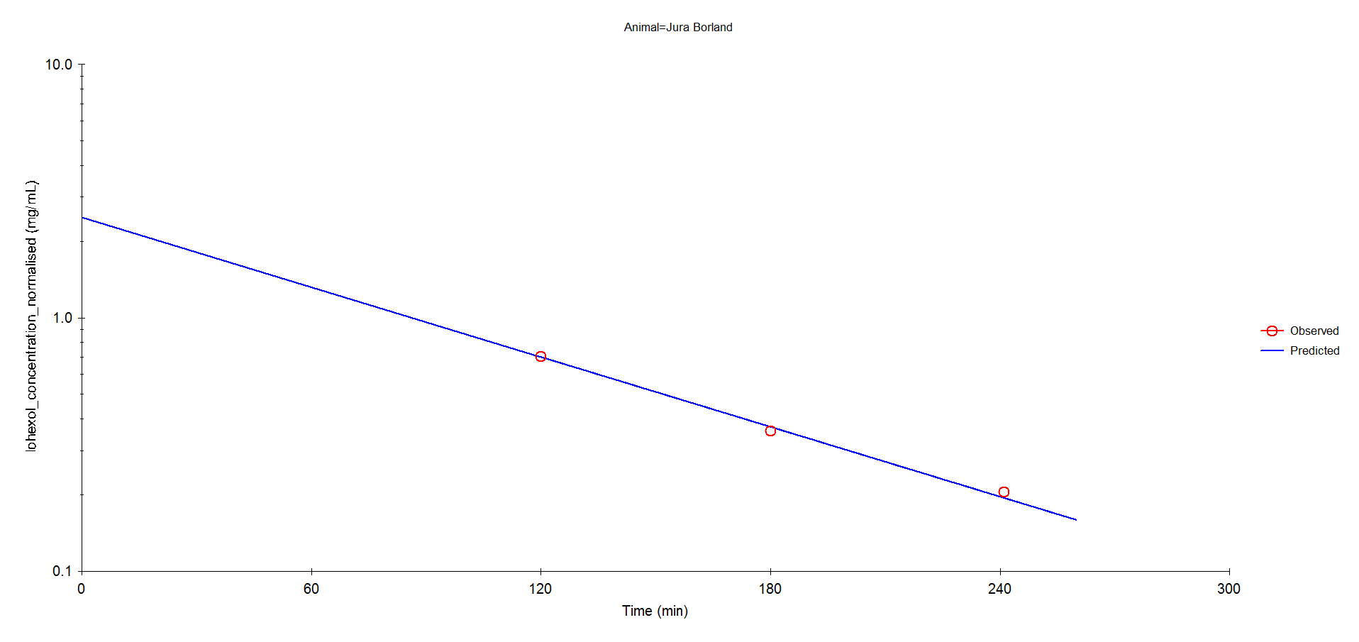
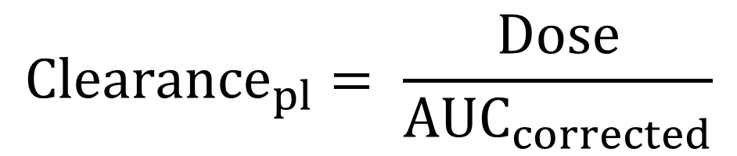
Correction for limited sampling: 3 samples
$${Clearance}_{pl}= \frac{Dose}{{AUC}_{corrected}}$$
Correction formula to extrapolate area above the blue line
Humans (Brochner-Mortensen formula)
Dogs (Bexfield/Heiene formula, JVIM, 2008)
Cats (Finch formula, AJVR, 2011)

Slide 11
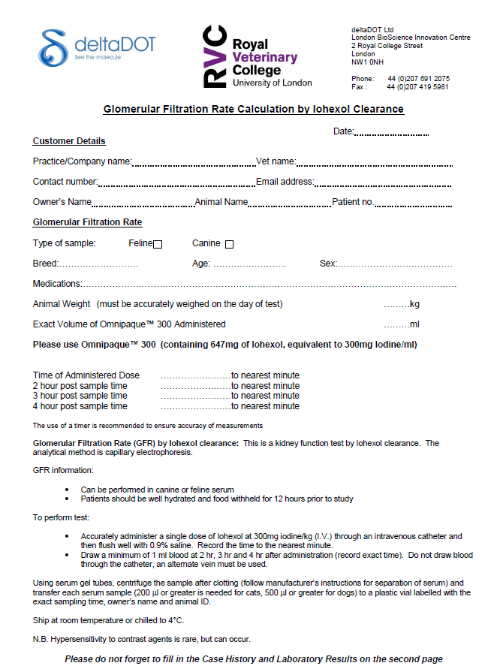
Iohexol clearance test in the UK
Previously only
run by Michigan
State University
UK test since 2013
Turnaround time 4 days from receipt

Slide 12
How to carry the test out?
Patients should be well hydrated and food withheld for 12 hours prior to study
Accurately administer a single dose of Iohexol (Omnipaque™ 300) at 300mg iodine/kg (I.V.) through an intravenous catheter and then flush well with saline.
Take blood at 2 hr, 3 hr and 4 hr after administration (record exact time).
Using serum gel tubes, centrifuge the sample after clotting and transfer each serum (<200 µL for cats and <1000 µL for dogs)
Ship at room temperature for next day delivery (stability demonstrated)

Slide 13
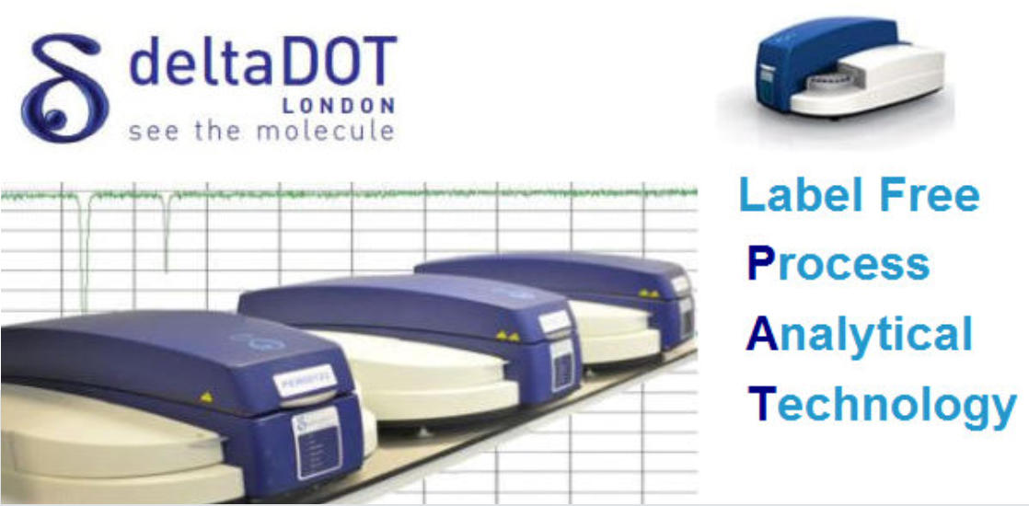
Few words on the iohexol measurement method:
Concept development partnership between deltaDot (LBIC) and RVC
High performance capillary electrophoresis
Daily performance of 7 points calibration curve
Inclusion of Quality Control samples
Good agreement with HPLC-UV (Epsom-St Helier) and LC-MS (Michigan State)
Corrected GFR interpreted by specialist panel in the light of previous history and laboratory results

Slide 14
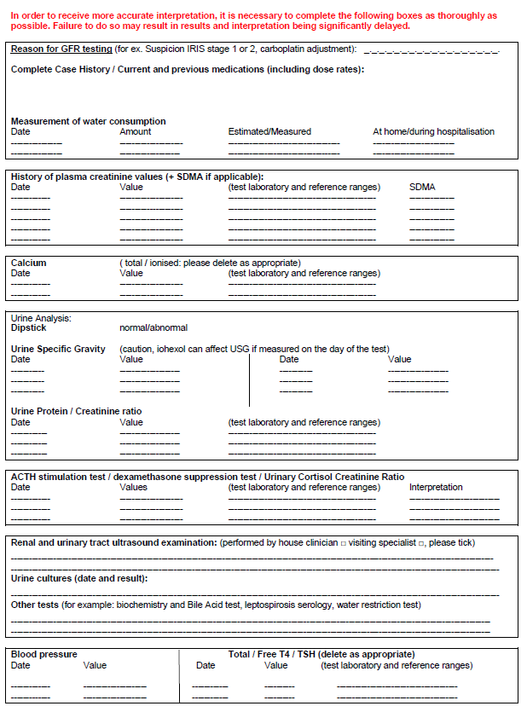
Medical and laboratory history
To allow more accurate interpretation
GFR calculated with PK software
Full interpretation after consultation with internal medicine colleague

Slide 15
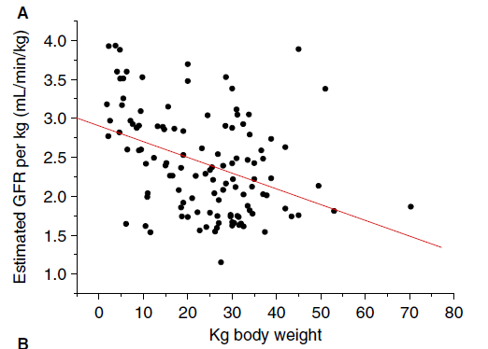
Reference range in Europe for dogs (Bexfield et al. 2008)
Weight in kg | 1.8-12.5 | 13.2-25.5 | 25.7-31.6 | 32-70.3
Mean | 2.89 | 2.4 | 2.16 | 2.25
Ref range | 1.54-4.25 | 1.29-3.50 | 0.95-3.36 | 1.12-3.39

Slide 16
Interpretation based on decrease from the mean or serial GFR for individual
Weight in kg | 1.8-12.5 | 13.2-25.5 | 25.7-31.6 | 32-70.3
Mean | 2.89 | 2.4 | 2.16 | 2.25
Ref range | 1.54-4.25 | 1.29-3.50 | 0.95-3.36 | 1.12-3.39
30 to 40%
decrease
from mean
> 40%
decrease
from mean

Slide 18
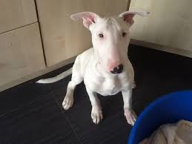
CASE 1) Suspected non azotaemic CKD and congenital renal disease
Thud, Bullterrier, 5 mo, ME
(12.8 kg) adopted from Dogs Trust
PUPD since approximately 2 months old (140 to 350 ml/kg/day)
Urine SG=1.008 to 1.012
Borderline creatinine: 101 to 108 µmol/L [RI 27-106]
Renal ultrasound: indistinct corticomedullary junction & lack of medulla. Almost appear ‘squashed’
Question: can congenital renal disease be supported despite borderline azotaemia?

Slide 19
CASE 1) Suspected non azotaemic CKD and renal dysplasia
2 negative urine cultures
Urinary Protein Creatinine ratio: intermittent proteinuria (1.3)
Total calcium and bile acid test: normal
GFR : 1.09 mL/kg/min
Average 2.4 mL/kg/min and reference range: 1.29-3.50 for weight quartile (adult weight)

Slide 20
CASE 1) Conclusion
Strong suspicion of congenital renal disease (dysplasia or Bull Terrier hereditary nephritis)
Prognosis for this dog is guarded and progression of renal disease could be rapid in the ensuing months
GFR result instrumental in the face of borderline azotaemia

Slide 21
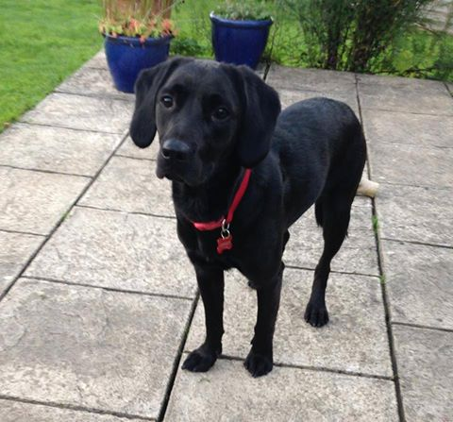
CASE 2) Advanced investigation of PUPD:
Phœbe, 17mo, FN, Labrador, 22kg
Presented with polyuria and polydipsia with minimally concentrated urine and occasional isosthenuria (1.012-1.015)
Plasma creatinine and urine protein/creatinine ratios were also within the normal range.
Other biochemistry tests were unremarkable
Kidneys ultrasound: normal sonographic appearance
Question: can a renal cause be excluded?

Slide 22
CASE 2: Advanced investigation of PUPD:
GFR was 2.44mL/kg/min
This represents a 1.6 % augmentation
from the expected mean GFR of 2.4 mL/kg/min for weight quartile
Clinical interpretation:
GFR value supporting normal renal function
Hospitalised the dog for few days, Phobe concentrated her urine
Urine culture and bile acid stimulation test: both negative
Psychogenic polydipsia remains the most likely diagnosis.
Follow up of the case with treating veterinarian:
Confirmed psychogenic polydipsia

Slide 23
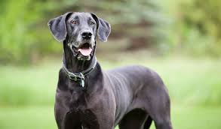
CASE 3) Bella, Great Dane
Great Dane, 4yo, 44kg
Water uptake 2.2 L /24h
Borderline creatinine values
Persistent proteinuria (UPC 1.33) and hypertension (190 mmHg) despite benazepril treatment
Renal US : unremarkable and no bacterial growth
GFR decreased by 29% compared to mean of group
Question: is it non azotaemic renal disease?
if so, GFR follow up organised
Renoprotection: management of hypertension and proteinuria with telmisartan and amlodipine

Slide 24
CASE 3) Bella, Great Dane: progressive CKD
Bella Follow up
 | 02/03/2015 | 20/03/2015 | 24/09/2015 | 18/05/2016 | 16/05/2017
GFR |  | 1.6 | 1.46 | 1.4 | 1.08
% decrease |  | 29% | 31.50% | 37.90% | 51.90%
Creatinine | 111 | 154 |  |  | 195
laboratory | In house | Finn Lab |  |  | NW labs
umol/L | [27-124] | [20-124] |  |  | [0-130]
Demonstrates the value of GFR follow-up to aid diagnosis of early renal disease and early intervention

Slide 25
CASE 4: Monitor progression of renal disease
Kirby, Labrador M, 4yo, 36kg
Renal adenocarcinoma removed by nephrectomy (normal creatinine at the time)
Azotaemia since after surgery that recovered to just below upper bound of reference interval
Question: can serial GFR measurement help to monitor the progression of existing CKD?

Slide 26
CASE 4: Monitor progression of renal disease
13/01:
Creatinine 148 -> 110 µmol/L [RI: 20-110]
USG: 1.022 – 1.036
GFR 1.48 mL/kg/min (34.1% reduction in comparison to the average GFR value )
Empirical adjustment carboplatin dose
23/03: (after 3 injections)
Creatinine 131 to 149 µmol/L [RI: 20-110]
USG: 1.028 - 1.034
GFR 1.48 mL/kg/min
No cytopaenia
Continued carboplatin treatment (same dose)
Conclusion:
Non-progressive CKD after uninephrectomy

Slide 27
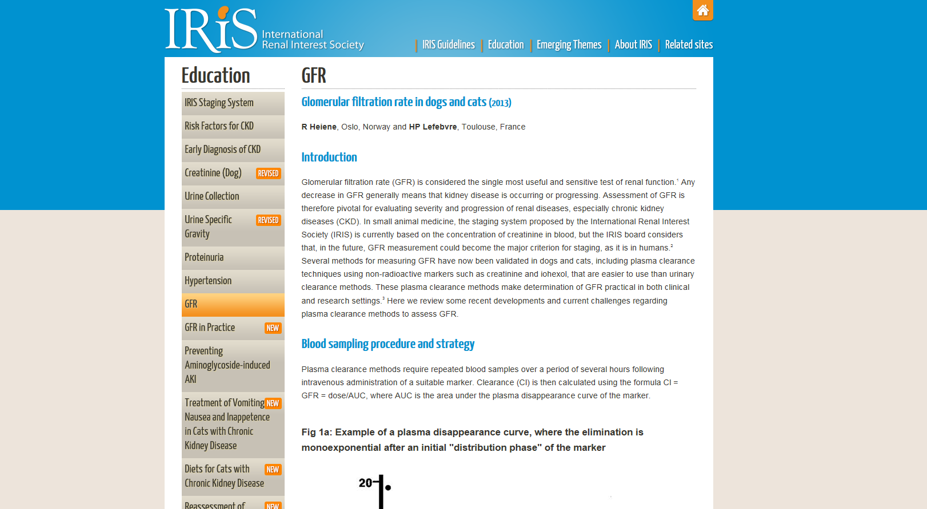
Impact of GFR measurement in clinical practice: IRIS guidelines

Slide 28
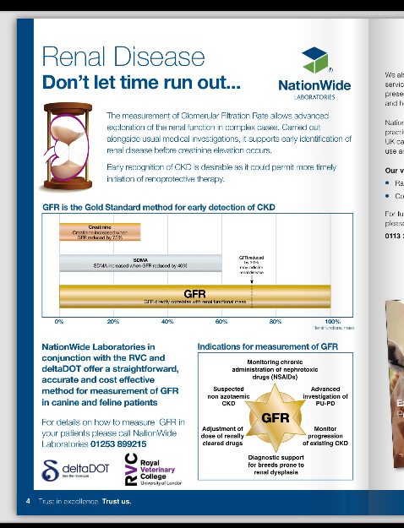
Impact of GFR measurement in clinical practice: national test (NW Labs)
Now receiving samples from France, Sweden and Denmark

Slide 29
Conclusion:
I wish I would have met Bob
He contributed to validation and clinical applicability this GFR test
Test is key to identify early decreased in renal function and understand inter-animal variability in drug clearance
We are developing applications to rats and horses

Slide 30
Thank you for your attention
Acknowledgments:
  - Dr. Sam Williams / Dr. Lesley Caldwell
  - Dr. Rosanne Jepson
  - Prof. Jonathan Elliott

Slide 31
Part 2: Assessment of kidney function and comparative nephrology
11.40 – 12.10 Measurement of GFR – a historical perspective to state of the art (Professor AM Peters Brighton and Sussex Medical School)
12.10 – 12.40 Feline kidney disease – research at the RVC to achieve early diagnosis (Professor Harriet M Syme, Royal Veterinary College)
12.40 – 14.00 Lunch and poster viewing
14.00 – 14.30 Measurement of GFR in the dog – (Dr Allison Gleadhill)
14.30 – 15.00 Use of iohexol clearance in dogs as a diagnostic test – does it help in early diagnosis of kidney disease (Dr Ludovic Pelligand – Royal Veterinary College)

Slide 32
IRIS staging
  http://www.iris-kidney.com/education/gfr.shtml
CKD staging according to creatinine
Stage | Plasma creatinine (µmol/L) | Comments
I | < 125 – dogs < 140 – cats [Non azotaemic] | Other renal abnormality present (e.g. inadequate concentration ability, abnormal palpation, proteinuria, creatinine trend)
II | 125 – 180 (dogs) 140 – 250 (cats) [mildly azotaemic, even if still within reference interval] | Clinical signs usually mild (e.g. PUPD) or may be absent
III | 181 – 440 (dogs) 250 – 440 (cats) [moderately azotaemic] | Many extrarenal clinical signs may be present.
IV | > 440 (dogs and cats) | Increasing risk of systemic clinical signs and uraemic crises

Slide 33
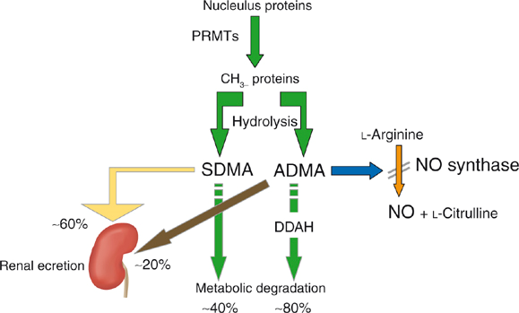
What is SDMA, the new promising marker?
SDMA = Symmetric dimethylarginine
Protein degradation product produced in every cell and released into the body’s circulation.
Excreted almost exclusively by the kidneys
Characteristics of a good marker for estimating kidney function
Commercialised by Idexx in the UK very soon

Slide 34
Advantages of SDMA over plasma creatinine
SDMA can identify CKD an average of 9 months earlier in dogs and 17 months sooner in cats, compared to serial creatinine measurement
SDMA is not impacted by muscle mass, therefore increased sensitivity in thin geriatric animals, especially cats and animals with other diseases that cause muscle wasting
Clinical cut off: 14 mcg/dL

Slide 35
How does SDMA relate to GFR?
Strong correlation between SDMA and GFR
SDMA increases when there is on average a 40% decrease in GFR
Performing a GFR clearance test is still the gold standard for assessing kidney function. The 2 tests will be complementary (GFR confirmation)
There could be other factors than GFR affecting SDMA (hypo/hyperthyroidism, hypertension, neoplastic disease)

Slide 36
What else?
Great clinically available tests for early identification of CKD and monitoring of renal reserve
Even more and coming tests : early identification of Acute Kidney Injury

Slide 37
Renal injury is often not detected
INSULT
1. FULL RECOVERY
100
2. AKI TO CKD
RENAL FUNCTION
3. ACUTE ON
CHRONIC KIDNEY
DISEASE
4. AKI TO
END STAGE
RENAL DISEASE
0
Adapted from Cerdá J et al. CJASN 2008; 3:881-886.

Slide 38
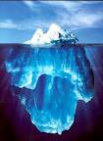
Quest for the ideal biomarker of acute renal injury
Creatinine only rises 48h after injury!
Ideal biomarker should be
- rapid and reliable increase in response to injury
- sensitive and specific for AKI
- correlated with injury severity and overall prognosis
- inexpensive and easy to measure
Identification of several promising biomarkers of AKI that can be measured in the blood or the urine.

Slide 39
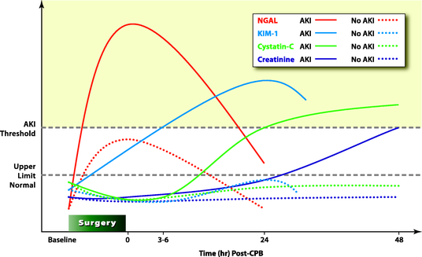
Urinary proteomics for markers of acute kidney injury
NGAL (Neutrophil gelatinase-associated lipocalin)
Riou et al.
Anesthesiology
2010
Cardio-pulmonary bypass in adults

Slide 40
NGAL – What is it?
Small (25kDa) protein up-regulated in renal injury
Measurable in urine and plasma in AKI
Level rises as early as 2 hours after cell injury
Stable in biological samples
Normalises with successful therapy (animal models)
NGAL detects AKI earlier than creatinine
Allows early intervention and monitoring of therapy
Haase K, et al. Curr Opin Crit Care 2010

Slide 41
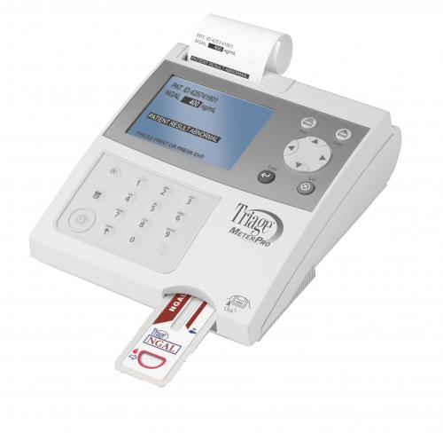
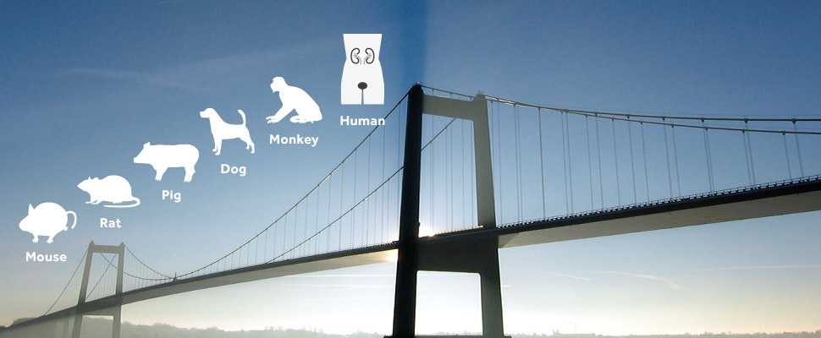
NGAL – Usability in clinics:
Human: point-of-care analyser in Europe
Canine assay: Research ELISA Bioporto®
Threshold defined in clinical dogs with AKI vs controls (Segev et al. JVIM, 2013)
Needs veterinary point of care
The NGAL bridge
Bioporto ELISA does work in cats!

Slide 42
Take home message:
This is exciting times for small animal nephrology!
TWO new commercial tests for early detection of renal disease
Allow identification of IRIS stage 1 CKD for early intervention:
- if proteinuria - antiproteinuria medication?
- if hypertensive - antihypertensive
- renal diets? There are indications that phosphate homeostasis is disturbed early in CKD
The benefits of these interventions in slowing progression to later stage CKD have not been studied.

Slide 43
Thank you for your attention
Acknowledgments:
  - Dr. Sam Williams / Dr. Lesley Caldwell
  - Dr. Rosanne Jepson
  - Prof. Jonathan Elliott

Slide 44
Reserve slides

Slide 45
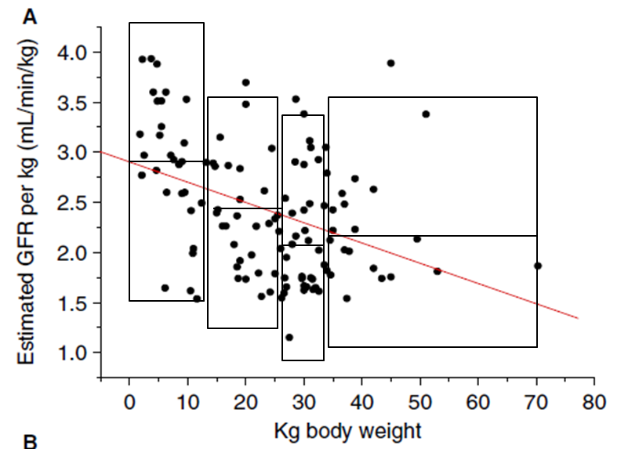
Alignment of reference range
Europe
Cat (Finch et al): 2.14 mg/kg/min (SD 0.34)
Dog (Bexfield et al): Range depends on weight
USA
Cat MSU: Range : 1.15 – 2.73 mg/kg/min
Dog MSU: Range : 3.89 – 8.07 mg/kg/min

Slide 46
Reconcile both sides of the Atlantic for canine reference range
Iohexol dose
Relationship | MSU | RVC | Ratio
Mean | 5.48 | 2.4 | 2.28
CI Lower bound | 2.89 | 1.29 | 2.24
CI Higher bound | 8.07 | 3.5 | 2.31
Phoebe | 5.47 | 2.4 | 2.24
What is calculated and reported by MSU laboratory is
iodine clearance using the dose of iohexol
Results 2.2-fold higher but reference range consistently higher too
Iodine AUC

Slide 47
SDMA history in veterinary medicine
Jepson 2008 (Plasma asymmetric dimethylarginine, symmetric dimethylarginine, l-arginine, and nitrite/nitrate concentrations in cats with chronic kidney disease and hypertension.)
Hall et al. JVIM 2014 (Comparison of serum concentrations of symmetric dimethylarginine and creatinine as kidney function biomarkers in cats with chronic kidney disease)
Braff et al. JVIM 2014 (Relationship between serum symmetric dimethylarginine concentration and glomerular filtration rate in cats)
Hall et al. Vet J 2014 (Comparison of serum concentrations of symmetric dimethylarginine and creatinine as kidney function biomarkers in healthy geriatric cats fed reduced protein foods enriched with fish oil, L-carnitine, and medium-chain triglycerides)
Hall et al. JVIM 2015 (Relationship between lean body mass and serum renal biomarkers in healthy dogs)
Nabity et al. JVIM 2015 (Symmetric Dimethylarginine Assay Validation, Stability, and Evaluation as a Marker for the Early Detection of Chronic Kidney Disease in Dogs)

Slide 48
IRIS: Interpreting Blood Concentrations of Symmetric Dimethylarginine (SDMA) in CKD
SDMA concentrations in blood (plasma or serum) may be a more sensitive biomarker of renal function than blood creatinine concentrations. A persistent increase in SDMA above 14 µg/dl suggests reduced renal function and may be a reason to consider a dog or cat with creatinine values <1.4 or <1.6 mg/dl, respectively, as IRIS CKD Stage 1.
In IRIS CKD Stage 2 patients with low body condition scores, SDMA ≥25 µg/dl may indicate the degree of renal dysfunction has been underestimated. Consider treatment recommendations listed under IRIS CKD Stage 3 for this patient.
In IRIS CKD Stage 3 patients with low body condition scores, SDMA ≥45 µg/dl may indicate the degree of renal dysfunction has been underestimated. Consider treatment recommendations listed under IRIS CKD Stage 4 for this patient.
These comments are preliminary and based on early data from the use of SDMA in veterinary patients. We expect them to be updated as the veterinary profession gains further experience using SDMA alongside creatinine, the long-established marker in diagnosis and monitoring of canine and feline CKD.

