Slide 1
GFR MEASUREMENT IN THE DOG (AND OTHER ANIMALS)
Allison Gleadhill MA VetMB CertSAD CertSAM PHD MRCVS
Crab Lane Vets, Harrogate

Slide 2
Summary of work done during my PHD – hopefully not too dated!

Slide 3
WHAT IS GFR
VOLUME OF PLASMA FILTERED BY KIDNEYS PER UNIT TIME
USING A FILTRATION MAKER = VOLUME OF PLASMA WHICH WOULD HAVE TO BE TOTALLY CLEARED OF A SUBSTANCE IN ORDER TO GIVE THE AMOUNT OF MARKER APPEARING IN URINE IN SAME PERIOD OF TIME

Slide 4
WHY MEASURE GFR?
MEASURES FILTRATION FUNCTION OF KIDNEY – MAIN DETERMINANT OF EXCRETORY FUNCTION
TRADITIONAL BIOCHEMICAL MARKERS OF RENAL FUNCTION RELATIVELY INSENSITIVE TO REDUCED FUNCTION UNTIL LARGE LOSSES OF RENAL FUNCTION HAVE OCCURED
ABLE TO PICK UP SMALLER DECREMENTS IN RENAL FILTRATION FUNCTION THAN CREATININE IN RENAL INSUFFICIENCY
NEED ABSOLUTE MEASURE OF RENAL FUNCTION TO ASSESS EFFICACY OF OTHER TESTS OF DETECTING REDUCED FUNCTION
NEED TO BEAR IN MIND THAT PRE RENAL DISEASE & PHSIOLOGICAL STATES CAN AFFECT GRF
NOT A SCREENING TEST

Slide 5
BREED DATA & CREATININE
BREED | MEAD | SD | RANGE
ALL | 86 | 24 | 39-134
GIANT | 106 | 23 | 64-151
DOBERMAN | 92 | 21 | 50-134
GSD | 96 | 21 | 53-138
LAB/RET | 88 | 22 | 44-149
GAZEHOUND | 106 | 23 | 60-152
SETTER | 79 | 16 | 47-110
BOXER | 100 | 20 | 59-140
SPANIEL | 74 | 19 | 36-111
CAV K CH SPANIEL | 71 | 17 | 37-104
TERRIER | 74 | 23 | 28-119
YORKIE | 64 | 18 | 29-100

Slide 6
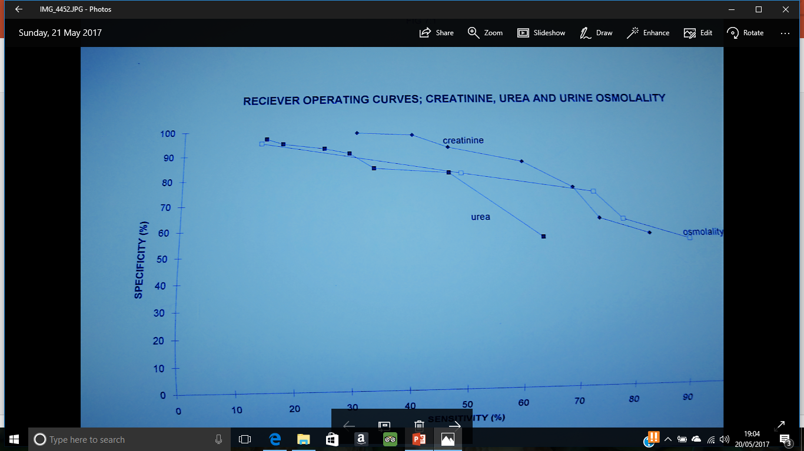
RECEIVER OPERATING CURVE
SHOWING HOW CHANGING CUT OFF AFFECTS SENSITIVITY & SPECIFICITY FOR STANDARD TESTS OF RENAL FUNCTION

Slide 7
LAST SLIDE SHOWED THAT CREATININE WAS MOST EFFICIENT SCREEN FOR REDUCED RENAL FUNCTION
DATA WAS DERIVED FROM ALL DOGS
WOULD HAVE BEEN IMPROVED IF CREATININE INTERPRETED WITH REGARD TO BREED OF DOG
COMBINATION OF WEIGHT MONITORING, URINANALYIS, BP MEASUREMENT (CATS) INTELLIGENT INTERPRETATION OF CREATININE, LOOKING AT TRENDS WITH COMBINATION OF CLINCAL EXAMINATION & HISTORY TO SCREEN FOR ANY DISEASE!

Slide 8
RENAL CLEARANCES
RENAL CLEARANCE = URINE CONCENTRATION OF A MARKER X OF URINE PRODUCED PER UNIT TIME / PLASMA CONCENTRATION OF MARKER
Infusing a marker at a rate to keep constant plasma level & measuring how much appears in urine over given time
Not at all practical – constant rate infusions, complete urine collection…….

Slide 9
PLASMA CLEARANCES
Give marker intravenously, diffuses throughout its distribution volume,
Once this occurs (>120mins) then rate of it leaving plasma is equivalent to its renal clearance
Assuming freely filtered, no metabolism, no tubular secretion/reabsorption etc this will equal GFR
Size of many markers means that their distribution volume equals ECFV
2 COMPARTMENT MODELS ADEQUATE (small quantity of non renal clearance means this could overestimate GFR at very LOW levels of renal function

Slide 10
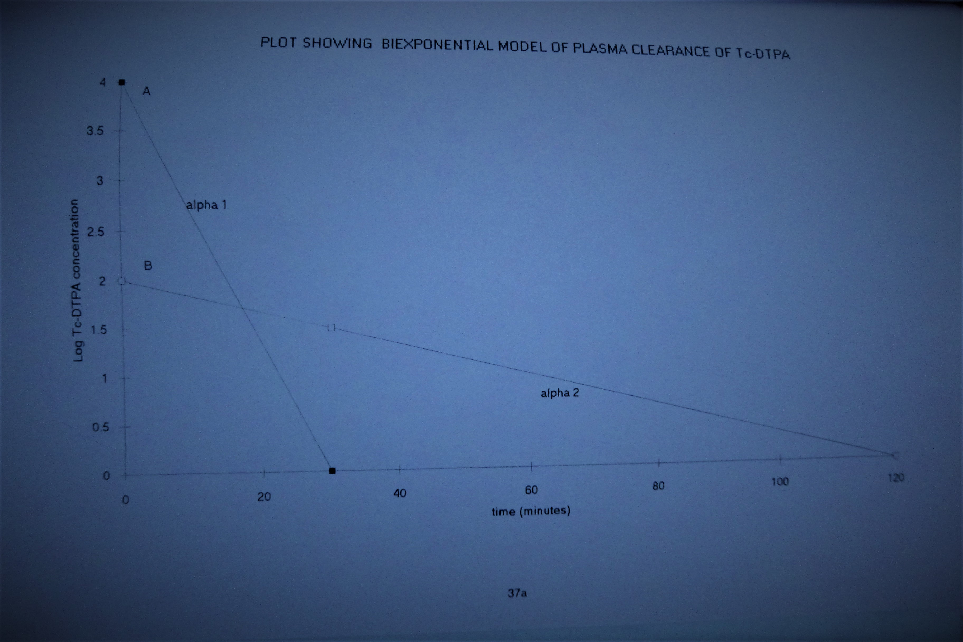
2 Compartment model for plasma clearance

Slide 11
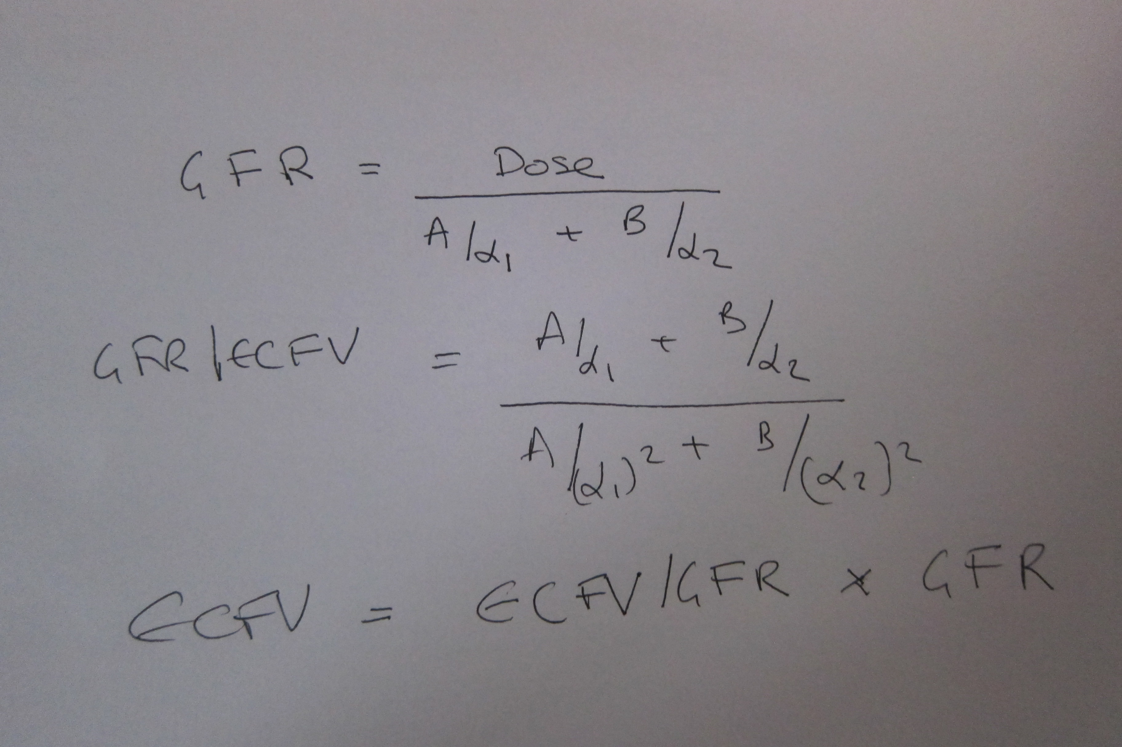
A a1 B a2 calculated for each dog then GFR, GFR/ECFV & ECFV all calculated
Polynomial relationship of GFR/ECFV TO a2 derived

Slide 12
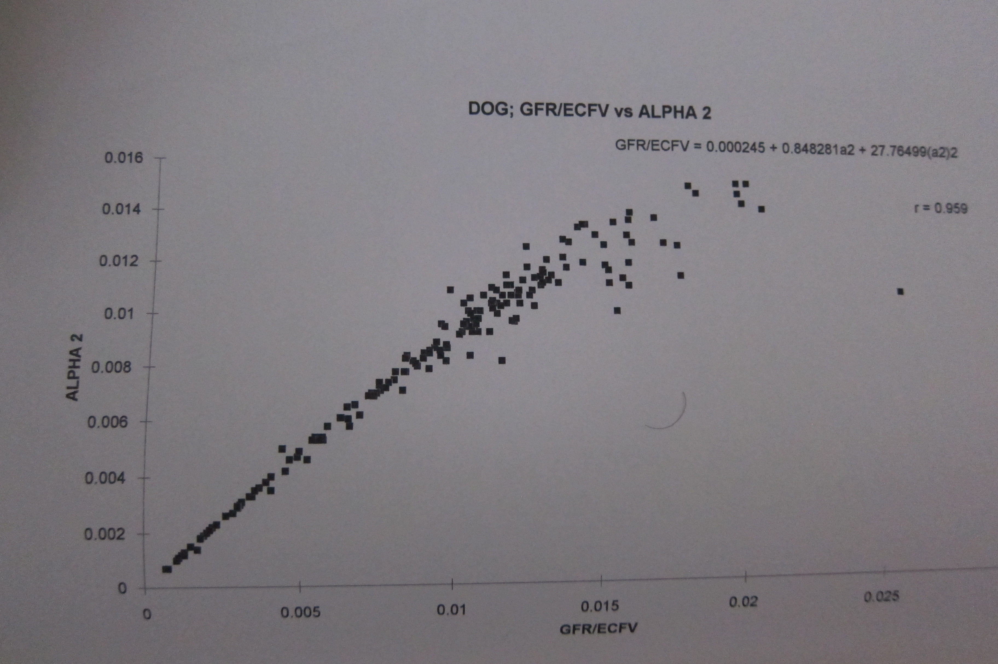
POLYNOMIAL RELATIONSHIP OF GFR/ECFV TO a2 DERIVED
AT ‘SUBNORMAL’ GFR THEN GFR/ECFV = a2 very similar graphs /equations produced for horses & calves

Slide 13
ADVANTAGES OF USING a2 TO GET GFR/ECFV
ONLY 3 BLOOD SAMPLES
NO DOSE MEASUREMENT NEEDED – one less error
POTENTAL USE OF EXTERNAL DETECTOR
NORMALISATION OF GFR TO ECFV; ECFV MAY WELL BE THE MOST PHYSIOLOGICALLY APPROPRIATE PARAMETER FOR NORMALISATION
EASY MATHS!
AT SUBNORMAL GFR THEN a2 = GFR/ECFV

Slide 14
NORMALISING GFR
RANGE OF SIZES IN DOGS 3.8-74.5KG RANGE USED
PEOPLE OFTEN USE PER BSA (BSA proxy for BMR), no gender difference in people using ECFV to normalise, no hyperfiltration in acromegaly –GFR increases, so does ECFV
EXPONENT RELATING GFR TO ECFV IN DOG WITH NORMAL CREATININES CLOSER TO UNITY THAN THAT RELATING GFR TO BODYWEIGHT OR BSA
BIWENGA FOUND EXPONENT RELATING GFR TO BODYWEIGHT TO BE 0.88 USING LARGE SIZE RANGE OF DOGS
WE GOT 0.9 – v similar
CROSS SPECIES STUDIES GET EXPONENTS RELATING GFR TO BODYWEIGHT OF 0.82-0.85 – close to those that relate BMR to bodyweight
DOGS exponent relating renal weight to bodyweight is 0.63 whereas the cross species exponent is 0.85. Implies small dogs have relatively bigger kidneys than large dogs (or big dogs relatively smaller kidneys).

Slide 15
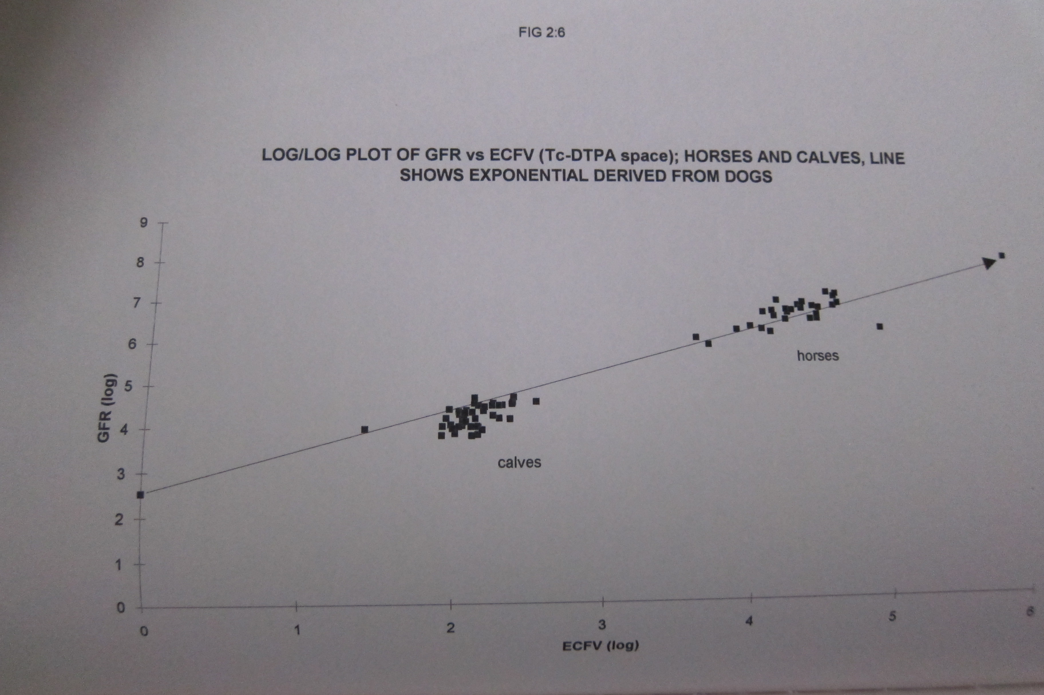
HORSE GFR/ECFV HAS SAME EXPONENT AS THAT DERIVED FOR DOGS; CALVES (<51 DAYS OLD) ON SLIGHTLY DIFFERENT SLOPE – YOUNG ANIMALS WITH LARGER ECFVS

Slide 16
TECHNETIUM DTPA
Appropriate filtration marker – freely filtered at glomerulus, not secreted/reabsorbed/ metabolised etc
Accessible – had generator as used for equine bone scanning
Easily & accurately measured – access to gamma counter
Short t ½ - ok to use in client owned dogs
Short t ½ had t o be borne in mind when doing the maths!
Not an in-practice test
Use of external probe technique
Could combine with imaging with gamma camera to assess individual renal filtration function

Slide 17
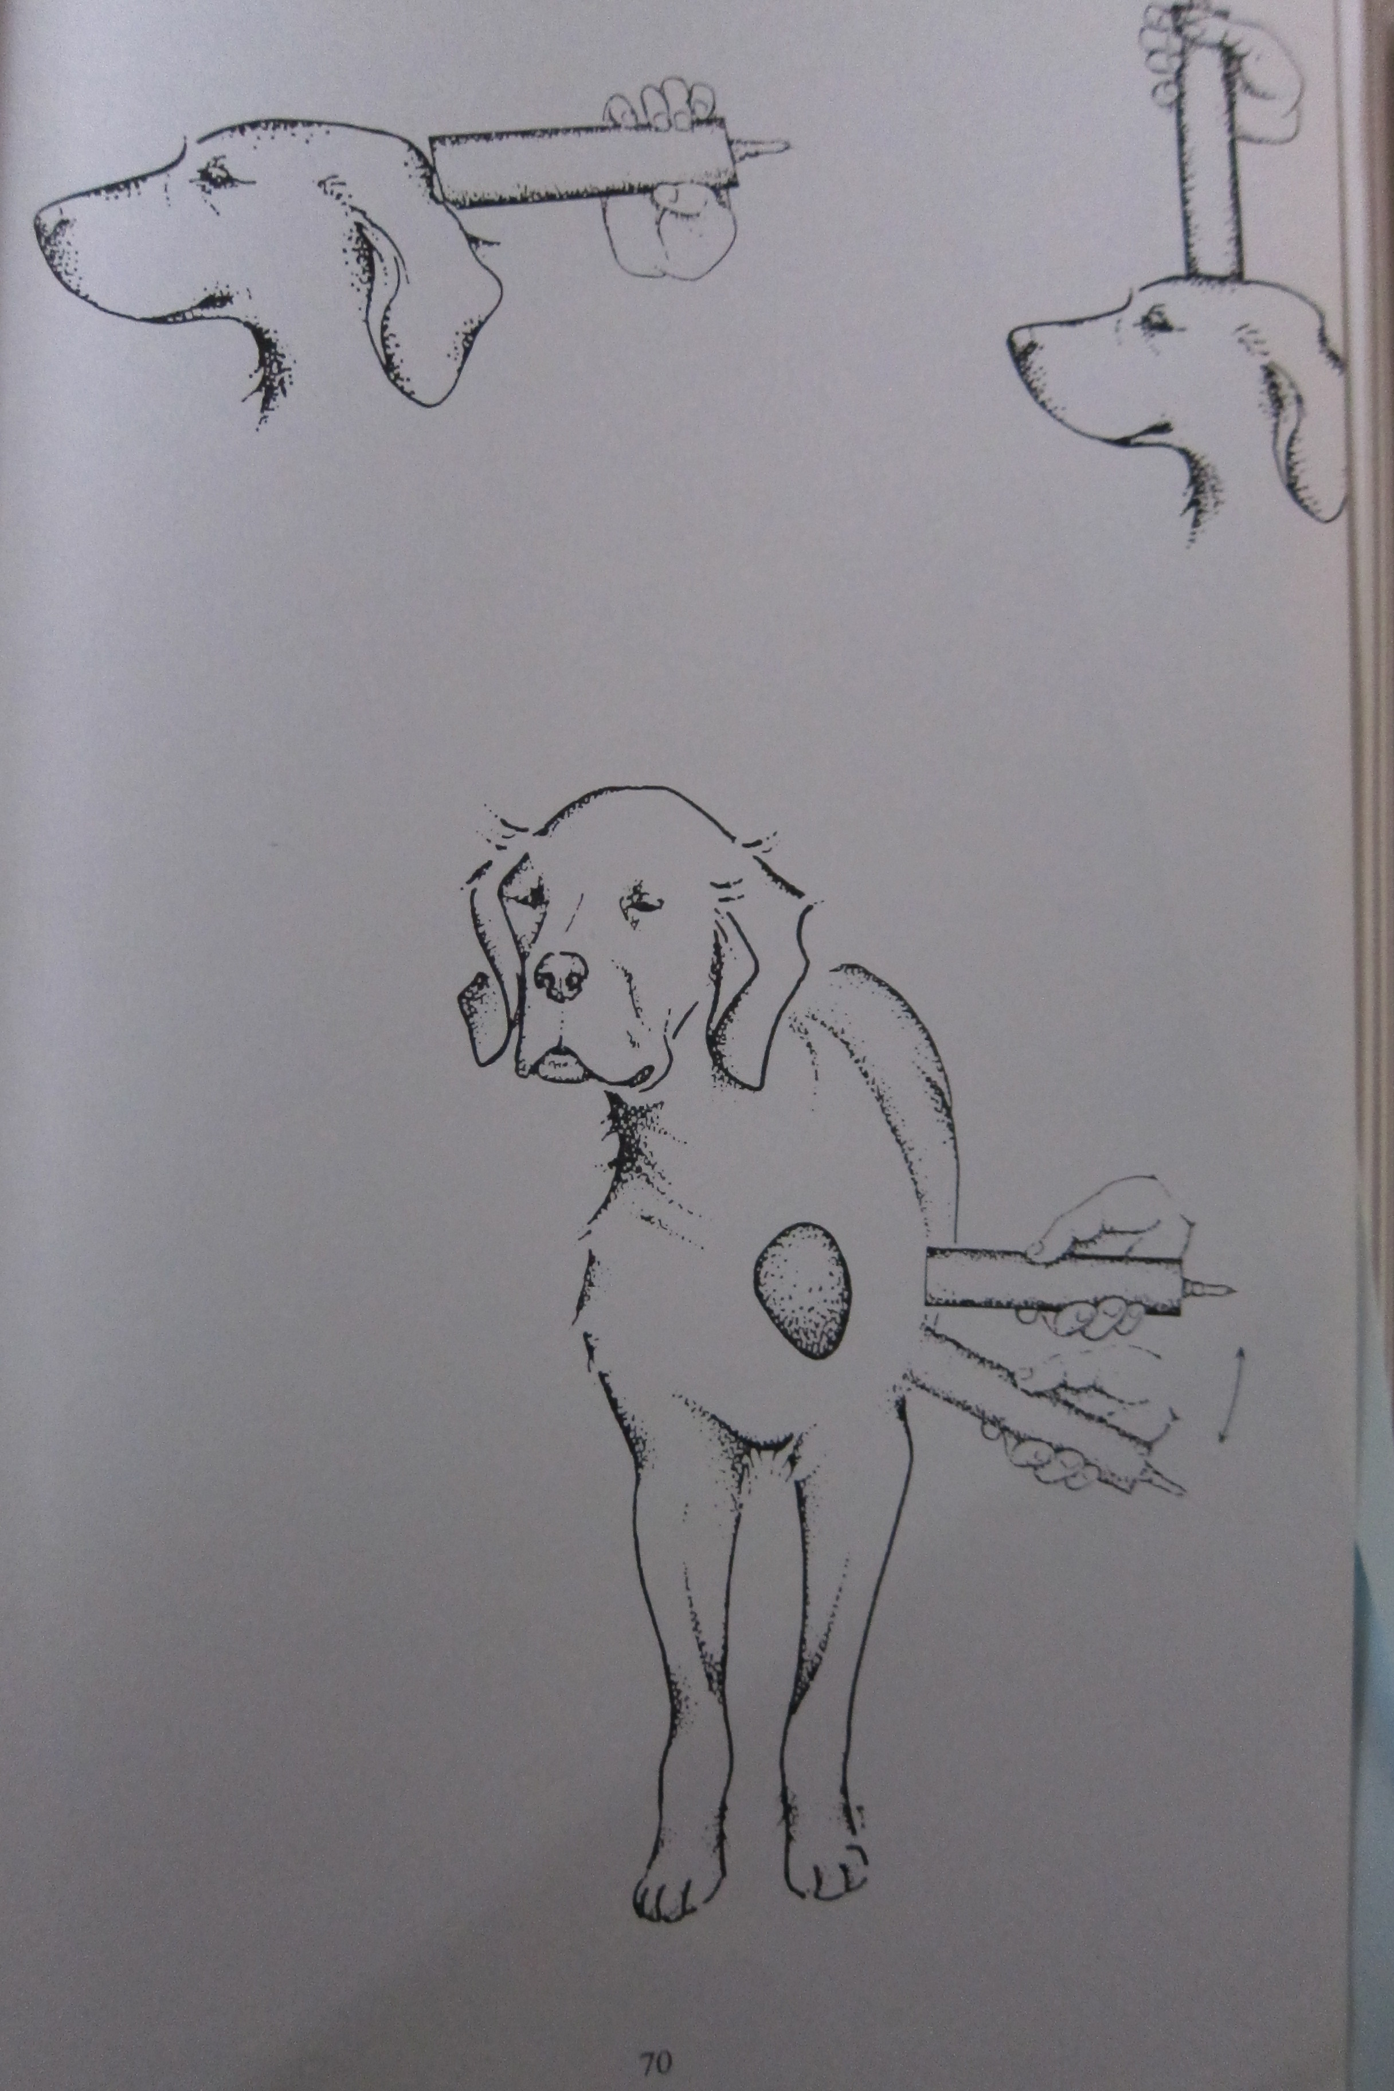
EXTERNAL PROBE TECHNIQUE
Took 3 measurements at same time as blood sample to derive a2
Head 2 best site
Did a few cats (3) using head site – could be v useful in this species

Slide 18
OTHER MARKERS
INULIN – unavailability, assay issues
EXOGENOUS/ENDOGENOUS CREATININE – some secretion
IOHEXOL – fine. Used RENALYZER – potential issues – sample size (3ml plasma) needed, issues with machine containing a long lived isotope (Americanium 241 t1/2 432 years).
NEW – FLOURESCENT LABELLED SINISTRIN. Only read about recently – use of external detector possible

Slide 19
WHAT IS NORMAL
POPULATION OF DOGS USED WERE ALL CLIENT OWNED & HAD TO HAVE A REASON TO MEASURE GFR, NOT RANDOMLY SELECTED
SOME DID HAVE CRF
USED RESULTS FROM 48 DOGS THAT I WAS PRETTY SURE WERE CLINICALY NORMAL ‘WORRIED WELL’ TO DERIVE ‘NORMAL’ GFR
IN THESE DOG GFR/ECFV WAS 0.0134 +/-0.0025 min-1 SO >0.01 TAKEN AS NORMAL.
CORRESPONDS TO @2ml/kg/min – similar to published normal ranges

Slide 20
FEEDING
ALL STANDARD MEASUREMENTS MADE AFTER 12H FAST WITH FREE ACCESS TO WATER
LOOKED AT 2 DOGS FASTED & FED
43% & 50% INCREASE IN GFR/ECFV BETWEEN MEASUREMENTS

Slide 21
VAMPIRE BAT (MacFarland & Wimsatt 1969)
Infrequently (once a day) consume large high protein meal often >37% bodyweight in short period of time
Expands ECFV by 20-25%
Too fat to fly!
25% meal volume urinated within 1 hour
High protein meal – rapid deamination & increase in plasma urea & osmolality – have to get rid of this
Rest of time small animal, large surface area vulnerable to evaporative losses – have to conserve water
GFR not yet measured in vampire bat yet….
……..Hummingbirds

Slide 22
INTERESTING CONCEPT –
THAT EATING IS A CHALLENGE
TO HOMEOSTASIS

Slide 23
HYDRATION
Previously demonstrated that fluid loading & fluid restriction will change GFR in the dog
Seasonal change in GFR between wet & dry season in sheep in Pakistan

Slide 24
EXERCISE AND GFR
Pre Atlanta Olympics
Gave horses TC DTPA took 3 samples during each phase of different exercise intensities (not extreme) when on treadmills. Looked at change in slope to see altered GFR/ECFV with exercise
GFR/ECFV fell between 20-65%
Only 4 horses but illustration of technique

Slide 25
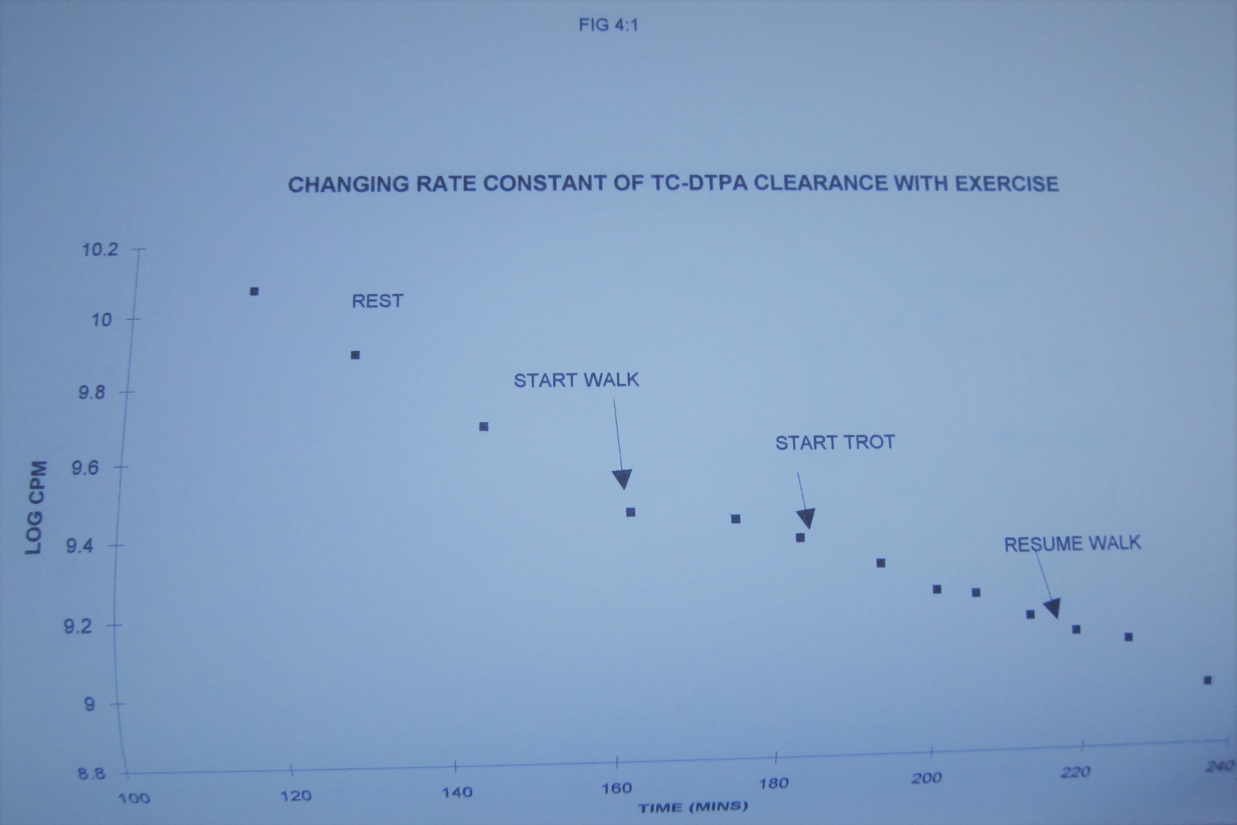
LOOKING AT CHANGES IN a2 AT DIFFERENT LEVELS OF EXERCISE IN HORSES

Slide 26
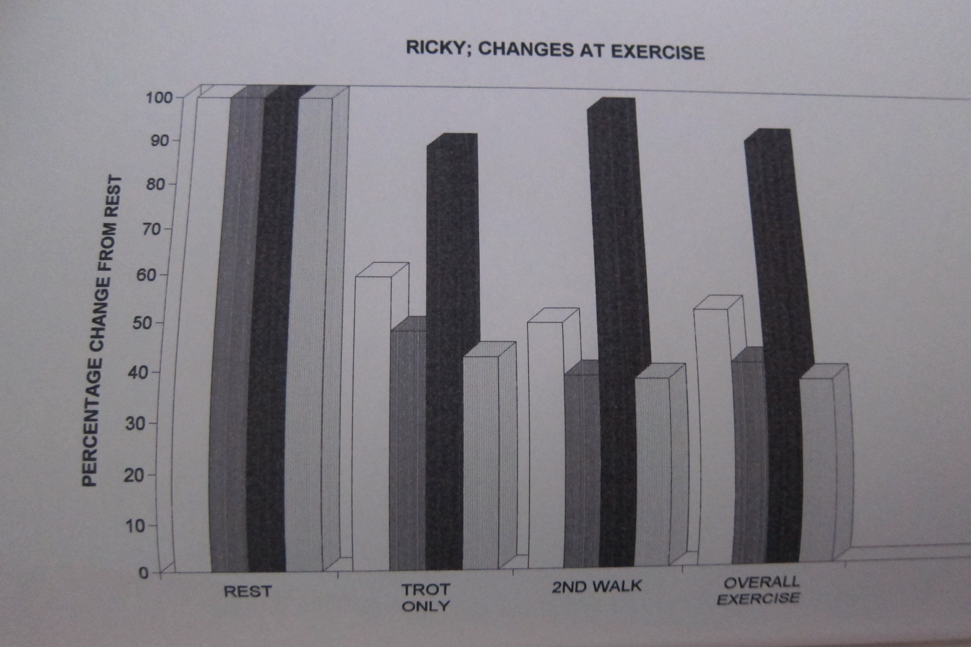
DROP IN a2 GFR/ECFV & GFR (little change in EFCV with exercise

Slide 27
THYROID STATUS
More recent studies showing that over & underactive thyroid status increases & decrease GFR respectively. Overfiltration may be damaging to kidneys in hyperthyroid cats & may give false sense of ‘ok’ renal function as assessed by pretreatment creatinine levels
ONE anecdotal EBT seen with hypothyroidism & slightly elevated creatinine; had low GFR @60% normal. Retested after treatment when creatinine was normal, dog was normal & GFR now in normal range. The time we used the gamma camera – specifically because this was a well behaved dog with a very ‘flat’ back that would balance on the gamma camera nicely. Turned out to only have 1 kidney!

Slide 28


