Slide 1
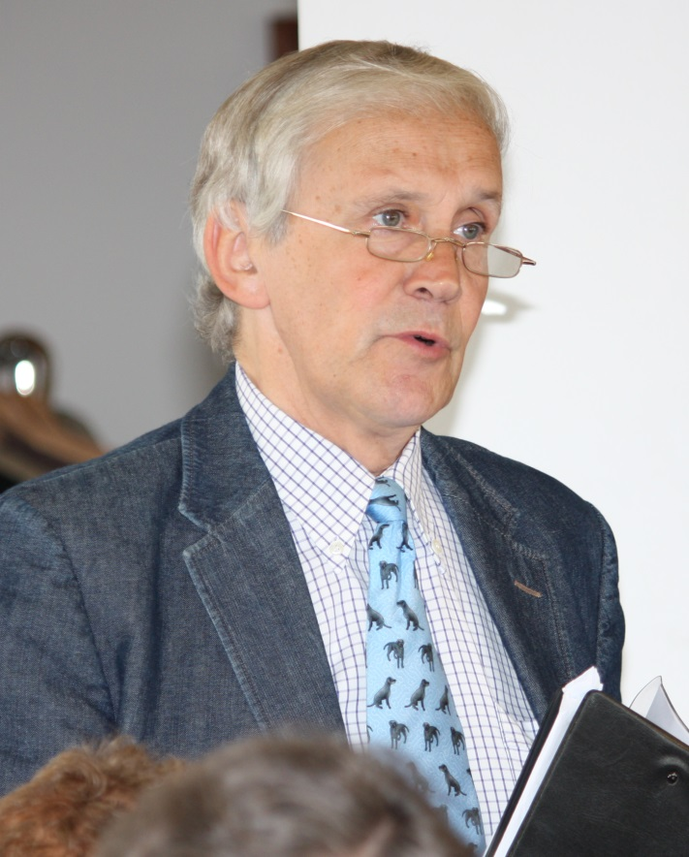
AlAstair Robert Michell a life

Slide 2
Comparative Physiology and Medicine Symposium – to commemorate the work of Professor A.R. Michell
Wednesday 31 May 2017
Sincere thanks to our sponsors
Idexx Laboratories
Norbrook Laboratories
Veterinary Times
AND Prof. J. Elliott and Liz Wilkinson

Slide 3
AlAstair Robert Michell:
Personal recollections of a life well-lived

Slide 4

Bob at RVC

Slide 5

Bob at RVC
BSc, BVetMed, PhD, DSc, FRSA, MRCVS
BSc First Class Honours
Vice-Captain RVC Boat Club
1964 President Students’ Union Society
BVetMed, (with FOUR prizes) MRCVS
PhD
1969 Harkness Fellow
Beit Memorial Research Fellow
1976 Lecturer
Reader
1989-91 President RVC Alumnus Association
Professor of Applied Physiology and
Comparative Medicine
1996 DSc

Slide 6
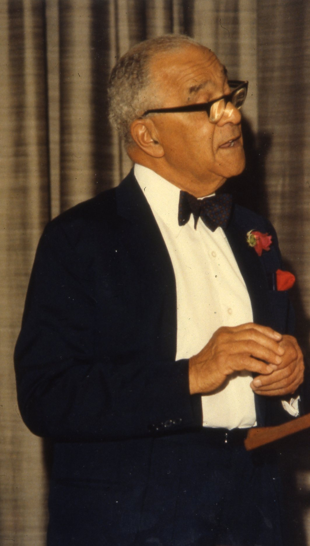
Emmanuel Cipriano Amoroso FRS
Professor of Physiology
Mentor to both Bob and myself
A great linguist and writer of wonderful prose

Slide 7
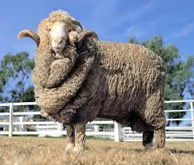
ANECDOTE ONE
There was no room for them in the inn. Luke: 2 ; 7.
Trespass: verb; unlawful entry into a persons land or property

Slide 8

Bob not at RVC (up to 1997)
Royal College of Veterinary Surgeons Council :12 years *
British Veterinary Association Council : 25 years **
Professional and Scientific Associations : 25
AVTRW President
Veterinary Research Club President
Industrial consultancies and research links : 18 companies
Awards and Prizes : too numerous to mention
Veterinary literature, 171 peer reviewed publications and 96 commentaries
Notably his Speculum column in Veterinary Times
* All Committees except Disciplinary Committee, including Presidential year
** Contribution to 17 BVA policy documents

Slide 9
Bob the disciplinarian alias Bob the Builder
Not discipline constrained
Chemist
Biochemist
Physiologist
Pharmacologist
Pathologist
Clinician
Statistician
Built the bridges between the disciplines

Slide 10
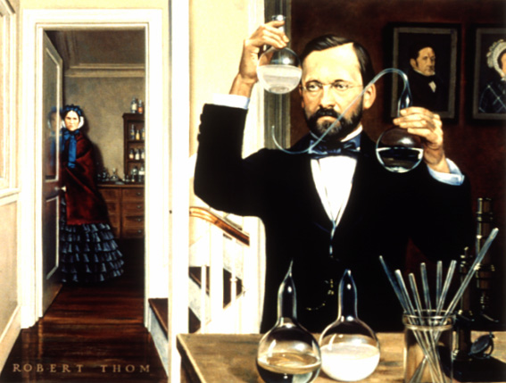
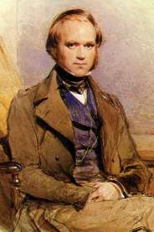
Bob not in the same league but cast in the same mould
Louis Pasteur Charles Darwin

Slide 11
Bob the Builder of Bridges
Chemistry of sodium and potassium
↓
Biochemistry of electrolytes
↓
Physiology of electrolytes in relation to
↓ ↓
Blood circulation Kidney
(hypertension) (disease)
Fluids to replace deficits in water, electrolyte + acid- base balance
“You have problems, I have solutions”
The Bridges so many of us have crossed

Slide 12
ANECDOTE TWO
Saving phenylbutazone
In 1979 phenylbutazone was on the verge of following the dodo and dinosaurs → extinction
A pharmacokinetic study in ponies at Glasgow Vet. School killed 5/13 animals within 12 days
Conclusion : pony breeds are susceptible to phenylbutazone toxicity
Lees and Michell: Vet. Rec. August 19 1979, no we think not – longest letter ever published
Studies at RVC in Hunters and thoroughbreds indicated that the problem was dose pure and simple

Slide 13

ANECDOTE THREE: a marvelOUS solution
Needed a milk replacer solution of low magnesium content
Michell A.R., White D.G., Higgins A.J., Moss P. and Lees P. (1986) The effect of induced hypomagnesaemia on the toxicity of imidocarb in calves. Res. Vet. Sci., 40, 264‑270.

Slide 14
AlAstair Robert Michell a life
An insatiable desire to know the causes and consequences of everything

Slide 15
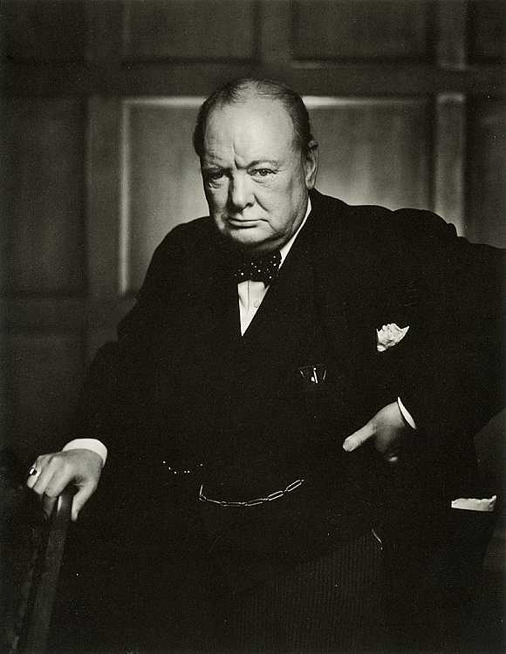
ON LIFE AND LIVING
We make a living by what we get
We make a life by what we give
Winston Spencer Churchill

Slide 16
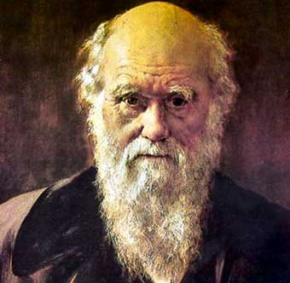
DARWIN: THE TIMES OBITUARY
19th April 1882
An epitaph and a legacy for Bob Michell

Slide 18
PASTEUR: THE TIMES OBITUARY
18th September 1895
If ever a man deserved a great
international monument, it is
surely this modest, unassuming,
gentle and humane French chemist ....
he surely deserves to be ranked among the
greatest benefactors of humanity

